Slide 1
Medical AI Diagnosis Prediction tool for Heart disease
By
Korie Westbrook
Kelvin Luk
Mansoor Haidari

Slide 2
Introduction:
Heart disease is the leading cause of death worldwide, causing millions of fatalities annually.
It encompasses various heart and blood vessel conditions, including coronary artery disease, heart failure, and arrhythmias.
Traditional diagnostic methods, such as physical exams and imaging tests, can be costly, time-consuming, or invasive.
This project aims to create an AI-powered medical diagnosis prediction tool using machine learning algorithms to predict heart disease based on patient data.
The tool has the potential to improve patient outcomes, decrease healthcare costs, and save lives.

Slide 3
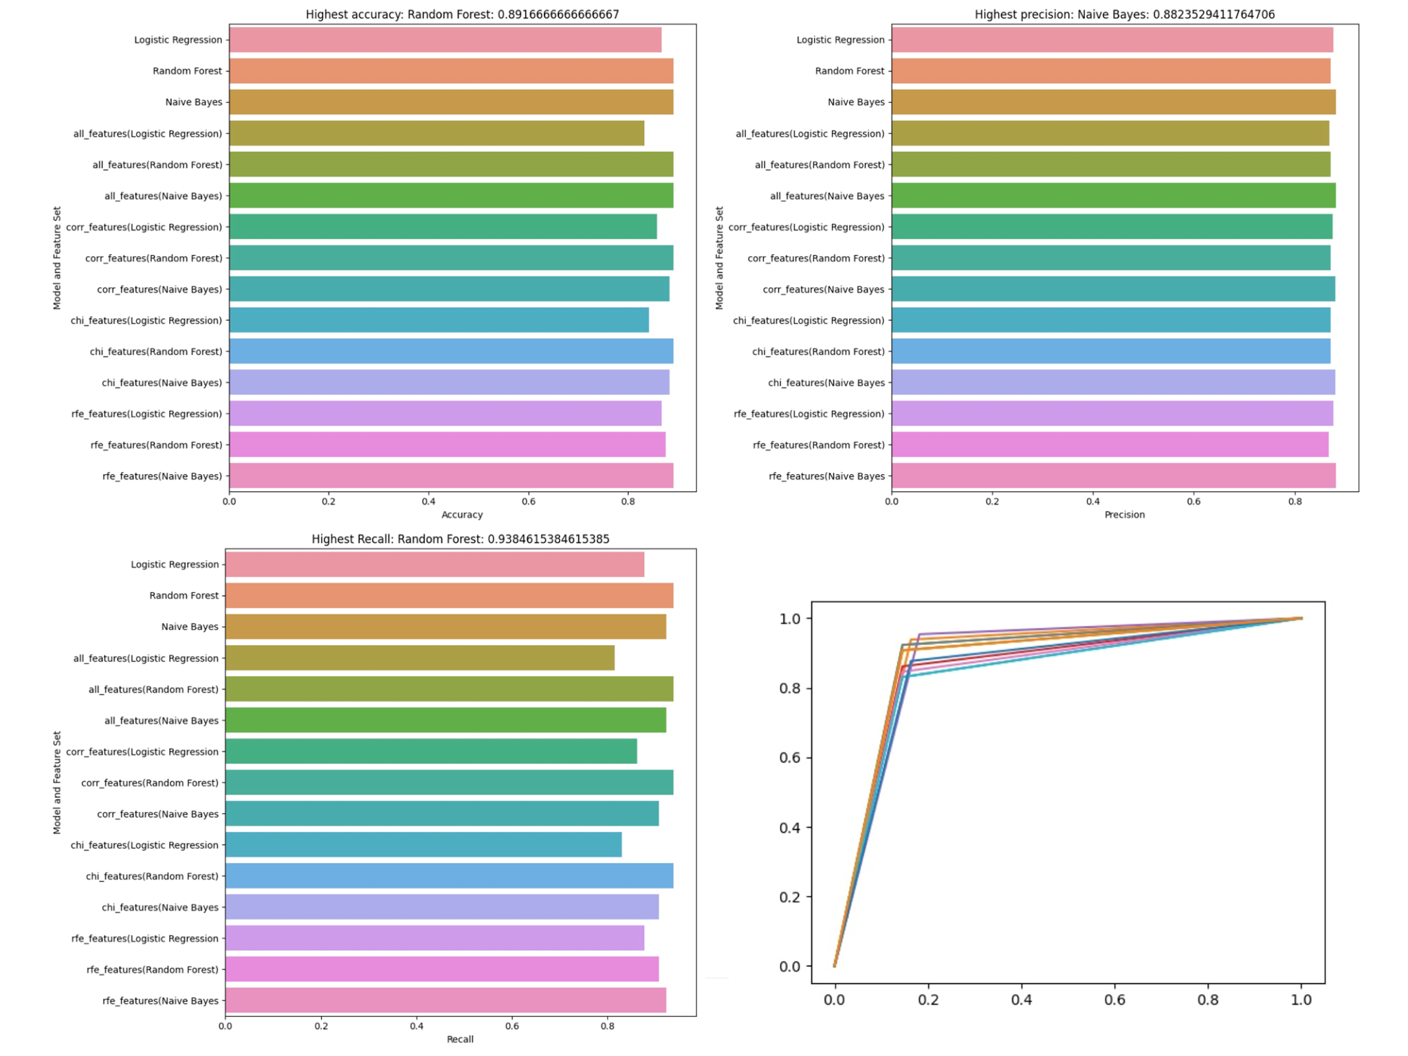
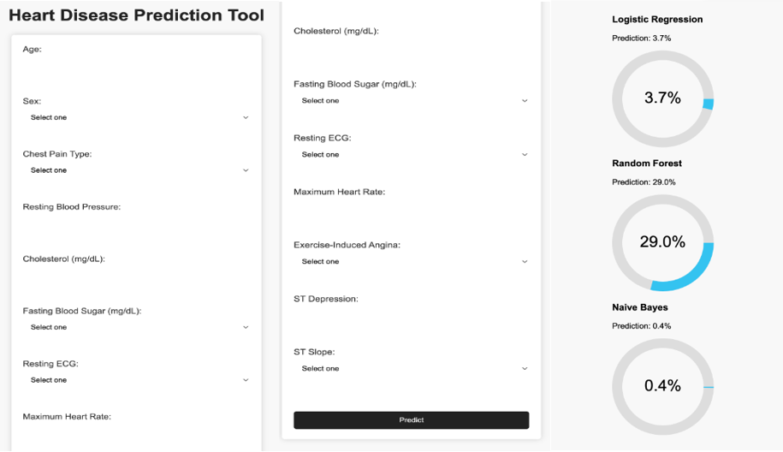
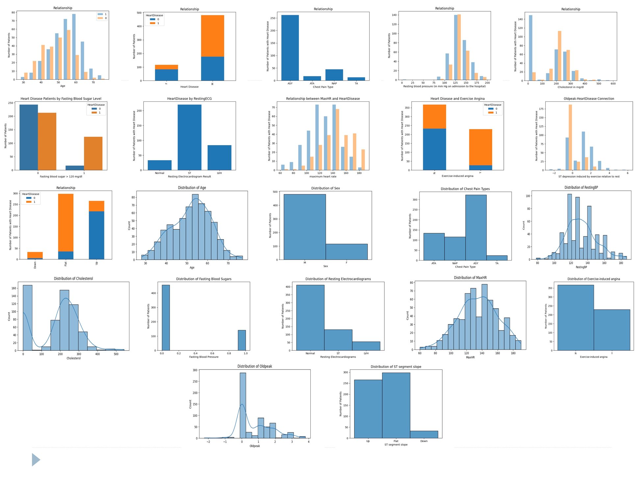
Implementation:
The Medical AI - Disease Diagnostic Prediction Tool is an application that uses machine learning and statistical models to predict diseases or medical conditions based on input data from the user. The application includes the following key characteristics:
Inputting patient symptoms and medical history
Data Cleaning and Preparation
Machine Learning/Statistical Models
Prediction Results.

Slide 4
Results:
The models has an accuracy rate of around 80% based on the data it has been trained on.
The model predicts the likelihood of heart disease and categorizes its prediction into one of four bins: Not Likely, Less Likely, Likely, and Highly Likely.
This labeling scheme makes it easy for users to interpret the model's prediction and determine whether they should get checked for heart disease.
The model can be integrated into a webpage, allowing users to input their data and receive a prediction on their likelihood of having heart disease.

Slide 5
Evaluation
The prediction tool was evaluated using a distinct test dataset to assess its performance and ability to generalize to new data.
Model evaluation criteria included accuracy, precision, recall, and the ROC curve.
The model performed well in predicting heart disease, with high scores for accuracy, precision, and recall.
The Receiver Operating Characteristic (ROC) curve revealed a trade-off between sensitivity and specificity, indicating the model's resilience in handling different decision thresholds.
Future research can focus on refining the model by experimenting with algorithms, feature selection, and parameter tuning to improve its predictive capabilities.

Slide 6
CONCLUSION
AI medical diagnostic prediction tool developed for heart disease using patient data.
Process included data preprocessing, feature selection, model training, evaluation, and user interface development.
Tool has potential to improve early identification and treatment of heart disease.
Lessons learned: importance of data quality, feature selection, and model fine-tuning.
Future enhancements: additional patient data sources, advanced machine learning techniques, improved user interface.
Continuous examination and upgrading necessary for accuracy and usefulness as new data and studies emerge.

Slide 7
Question?

